Slide 1
Lesson 304.5 - Aggregate Functions and Operators

Slide 2
Section 1
______________________________________
SQL Aggregate Function
Learning Objective:
By the end of this lesson, learners will be able to:
Describe aggregate functions.
Demonstrate aggregate functions.

Slide 3
Table of Contents
Overview of Aggregate Function.
String Functions.
Numeric/Math Functions.
Formats for Date and Time.
Advanced Functions.
MD5() Function.
CAST() Function.

Slide 4
Overview of Aggregate Function
SQL has many built-in functions, which are broken into many categories. Four common categories are listed below:
String Functions.
Numeric/Math Functions.
Date and Time Functions.
Advanced Functions.
Example: MAX(), Min(), Count(), ASCII(), CHAR_LENGTH(), CHARACTER_LENGTH (), CONCAT(), FORMAT(), INSERT(), LCASE(), LENGTH(), LOCATE(), LOWER(), LPAD(), LTRIM(), MID(), POSITION(), REPEAT, REPLACE(), REVERSE(), RIGHT(), RPAD(), SUBSTR(), TRIM(), UPPER(), SUM() Function and more
Reference to below link for all functions:
https://www.techonthenet.com/mysql/functions/index_alpha.php
https://dev.mysql.com/doc/refman/8.0/en/built-in-function-reference.html
Note: We cannot use aggregate functions within the WHERE clause.

Slide 5
String Functions
Let's demonstrate the most commonly used SQL String functions that allow you to manipulate character string data effectively.

Slide 6
String Functions → REPLACE() Function
SQL provides you with a useful string function called REPLACE(), that allows you to replace a string in a column of a table by a new string or replaces all occurrences of a substring within a string, with a new substring.
Syntax of the REPLACE() function is: REPLACE(str,old_string,new_string);
The REPLACE() function has three parameters. It replaces the old_string by the new_string in the string.
The REPLACE() function is very handy to search and replace text in a table such as updating obsolete URL or correcting a spelling mistake, etc.
Note: The REPLACE() function performs a case-sensitive replacement.
Example:
Select REPLACE('abc.org', 'abc', 'perscholas');
#output → perscholas.org
SELECT REPLACE('abc abc', 'a', 'B');
#output → 'Bbc Bbc'

Slide 7
String Functions → TRIM() Function
The TRIM() function removes all specified characters, from either the beginning or the end of a string.
TRIM() to help you clean up the data. The following illustrates the syntax of the TRIM() function.
TRIM( [ {BOTH|LEADING|TRAILING} [removed_character] ] FROM Given_String);
The TRIM() function provides a number of options. You can use the LEADING, TRAILING, or BOTH options to explicitly instruct the TRIM() function to remove leading, trailing, or both unwanted characters from a string.
Example:
SELECT TRIM(LEADING '@' FROM '@perscholas.org@@@'); # Result → perscholas.org@@@
SELECT TRIM(TRAILING '@' FROM '@perscholas.org@@@'); # Result → @perscholas.org
SELECT TRIM(BOTH '@' FROM '@perscholas.org@@@'); # Result → perscholas.org
SELECT TRIM( '@' FROM '@perscholas.org@@@'); # Result → perscholas.org
SELECT TRIM(LEADING '0' FROM '000123'); # Result → '123'
SELECT TRIM(TRAILING '1' FROM 'Tech1'); # Result → 'Tech'
SELECT TRIM(BOTH '123' FROM '123Tech123'); # Result → 'Tech'
Note: If you do not specify a value for the first parameter (LEADING, TRAILING, BOTH), the TRIM() function will default to BOTH and remove character or string from both the front and end of string.
Notes:
Why we need TRIM() → One of the most important tasks in data cleaning is to remove the unwanted leading and trailing characters. The data from user’s input is typically not what we expected. Sometimes, it is not well-formed, such as wrong cases, or some that even contain leading and trailing spaces and other unwanted characters. To keep the data in the correct format, before inserting or updating data in the database, you need to clean it up.

Slide 8
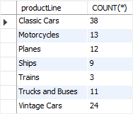
String Functions 🡪 COUNT(*) and COUNT(fieldname)
The COUNT(*) function returns the total number of records meeting the (optional) WHERE criteria:
Example:
SELECT COUNT(*) FROM products; #Result: 110 (result might be vary)
SELECT COUNT(productLine) FROM products; # Result: 110
We get a same result in both above queries.
The COUNT(*) function is often used with a GROUP BY clause to return the number of elements in each group.
For example, that statement below uses the COUNT() function with the GROUP BY clause to return the number of products in each product line:
SELECT productLine, COUNT(*) FROM products GROUP BY productLine;
Note: COUNT(*) is unique among the aggregate functions – it counts NULL values. This is because it counts rows, not fields.

Slide 9
String Functions 🡪 MAX() and MIN()
MIN() and MAX() functions return single values from a recordset. Note that selecting MIN() or MAX() from an empty resultset returns a NULL.
The below query uses the MAX() function to find the largest payment in 2004:
The below query uses the MIN() function to find the lowest buy price of all motorcycles from productline table.
SELECT MAX(amount), MIN(amount) FROM payments;
Result: MAX(amount) = 120166.58
MIN(amount) = 615.45
SELECT MAX(amount) as largest_payment_2004 FROM payments WHERE YEAR(paymentDate) = 2004;
#Result 🡪 largest_payment_2004 = 116208.40
SELECT MIN(buyPrice) FROM products WHERE productline = 'Motorcycles';
#Result 🡪 MIN(buyPrice) = 24.14
Notes:
You final result might be different .

Slide 10
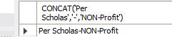
String Functions 🡪 CONCAT() Function
To join two or more strings into one, we can use the CONCAT() function, which takes one or more string arguments and concatenates them into a single string. The CONCAT() function requires a minimum of one parameter; otherwise, it raises an error.
Syntax:
CONCAT(string1,string2, ... );
Example:
SELECT CONCAT('Per Scholas','-','NON-Profit');
Result:

Slide 11
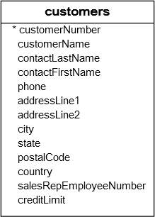
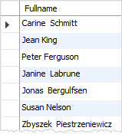
Example: CONCAT() Function
Consider the customers table in the classicmodels database.
To get the full names of contacts, we can use the CONCAT() function to concatenate first name, space, and last name, as shown in the below query.
SELECT concat(contactFirstName,' ',contactLastName) AS Fullname
FROM customers;
Result:

Slide 12
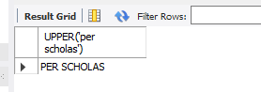
String Functions 🡪 UPPER() Function
The UPPER() function converts all characters in the specified string to uppercase. If there are characters in the string that are not letters, they are unaffected by this function.
Example:
SELECT UPPER('per scholas');
Result:

Slide 13
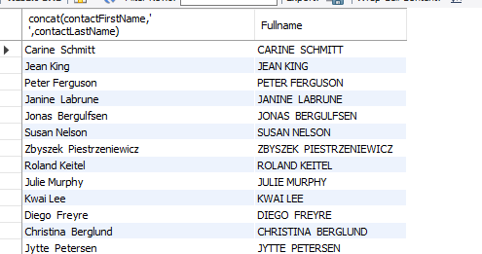
Example: UPPER() Function
Consider the customer's table in the classicmodels database. To get the full names of contacts, we can use the CONCAT() function to concatenate first name, space, and last name. We can convert all characters into the upper letters by using the UPPER() function as shown in the below query.
SELECT concat(contactFirstName,' ',contactLastName), UPPER(concat(contactFirstName,' ',contactLastName)) AS Fullname
FROM customers;
Result:

Slide 14
Numeric/Math Functions
Let's demonstrate the most commonly used SQL Numeric/Math Functions. MySQL Math Functions are the MySQL built-in functions, which refer the numeric type functions and commands to operate the mathematical logics.

Slide 15
Numeric/Math Functions → SUM() Function
The SUM() function calculates the sum of a set of values. Note: NULL values will be are ignore in SUM().
Example 1
SELECT SUM(Quantity) AS TotalItemsOrdered FROM OrderDetails;
# Above query return the sum of the "Quantity" field in the "OrderDetails" table
Example 2
SELECT SUM(amount) AS "Total amount" FROM payments;
#Result 🡪 8853839.23
. Example 3
SELECT SUM(quantityOrdered * priceEach) as orderTotal
FROM orderdetails
WHERE orderNumber = 10100;
#Result 🡺 orderTotal = 10223.83

Slide 16
Numeric/Math Functions → AVG() Function
AVG(): Return the average of non-NULL values.
The below query uses the AVG() function to calculate the average buy price of all products from the products table:
The following example uses the AVG() function to calculate the average buy price of products in the product line Classic Cars:
Note: SUM() and AVG() functions return a value calculated across all rows of a recordset.
SELECT AVG(buyprice) as 'Average Price' FROM products; #Result🡪 54.395182
SELECT AVG(buyprice) as 'Average Classic Cars Price'
FROM products
WHERE productline = 'Classic Cars';
#Result 🡪 Average Classic Cars Price = 64.446316

Slide 17
Numeric/Math Functions → MOD() Function
The MOD() Function returns the remainder of one number divided by another.
Syntax: MOD(dividend,divisor).
The MOD() function accepts two arguments:
dividend is a literal number or a numeric expression to divide.
divisor is a literal number or a numeric expression by which to divide the dividend.
The MOD() function returns the remainder of dividend divided by divisor. If the divisor is zero, the MOD(dividend, 0) returns NULL.
Examples:
SELECT MOD(11, 3); #Result: 2
#This above query divides the number 11 by 3. It returns 2 as the integer portion of the result.
SELECT MOD(12, 5); #Result: 2
SELECT MOD(12, 0.18); #Result: 0.12
SELECT MOD( o.quantityOrdered , 2) AS `MOD_DATA`, o.quantityOrdered
FROM orderdetails o;

Slide 18
Numeric/Math Functions → ROUND() Function
The ROUND() function allows you to round a number to a specified number of decimal places.
Syntax: ROUND(n,[d]) - In this syntax, n is a number to be rounded, and d is the number of decimal places to which the number is rounded. The number of decimal places (d) is optional, it defaults to zero if skipped. The following statements are equivalent:
SELECT ROUND(20); 🡪 Result 20
SELECT ROUND(20.5, 0); 🡪 Result 21
The number of decimal places (d) can be positive or negative. If it is negative, the d digits left of the decimal point of the number n become 0.
Examples:
SELECT ROUND(135.375, 2); # Result: 135.38 //Round the number to 2 decimal places:
SELECT ROUND(-125.315); # Result: -125
SELECT ROUND(121.55,-2); # Result : 100
SELECT ROUND(121.55,-1); # Result: 120
SELECT ROUND(125.315, 1); # Result: 125.3 //Round the number to 1 decimal places:
SELECT ROUND(125.315, -2); # Result: 100
SELECT ROUND(priceEach, 0), priceEach FROM orderdetails;
See also the FLOOR, CEIL, CEILING, and TRUNCATE functions.

Slide 19
Numeric/Math Functions → TRUNCATE() Function
The TRUNCATE() Function truncates a number to a specified number of decimal places:
Syntax: TRUNCATE(X,D) - In this syntax:
X is a literal number or a numeric expression to be truncated.
D is the number of decimal places to truncate to. If D is negative, then the TRUNCATE() function causes D digits left of decimal point of X to become 0. In case D is 0, then the return value has no decimal point.
Notice that the TRUNCATE() function is similar to the ROUND() function in terms of reducing the number of decimal places. However, the TRUNCATE() function does not perform any rounding as the ROUND() function does.
Examples:
SELECT TRUNCATE(125.315, 0); # Result: 125
SELECT TRUNCATE(125.315, 1); # Result: 125.3
SELECT TRUNCATE(125.315, 2); # Result: 125.31
SELECT TRUNCATE(125.315, -1); # Result: 120
SELECT TRUNCATE(125.315, -2); # Result: 100
SELECT TRUNCATE(-125.315, 0); # Result: -125

Slide 20
Numeric/Math Functions
Let's demonstrate the most commonly used SQL Date and Time Functions. The SQL date and time functions are responsible for extracting the data section from the specified date or expression “DateTime.”

Slide 21
Formats for Date and Time
Let’s view some of the Data Types formats used in SQL for DATE and TIME functions and for storing the values:
DATE: YYYY-MM-DD
DATETIME: YYYY-MM-DD HH:MM:SS
TIMESTAMP: YYYY-MM-DD HH:MM:SS
YEAR: YYYY or YY

Slide 22
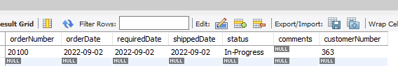
Date Functions → CURRENT_DATE() Function
The CURRENT_DATE() function returns the current date, as a 'YYYY-MM-DD' format. If used in a string context.
Syntax for the CURRENT_DATE function in SQL is:
CURRENT_DATE() or CURDATE()
Example:
SELECT CURRENT_DATE() ; # Result → 2022-09-01 (Note: Your result will be different.)
SELECT CURDATE(); # Result → 2022-09-01 (Note: Your result will be different.)
INSERT INTO orders (orderNumber, orderDate, requiredDate, shippedDate,status,customerNumber)
VALUES
(20100, CURRENT_DATE(),CURRENT_DATE(),CURRENT_DATE(),'In-Progress',363 );
#Result 3: A new record should be added to the orders table with the current date.

Slide 23
Date Functions → CURRENT_TIME() Function
The CURRENT_TIME() function returns the current time.
The CURRENT_TIME() function will return the current date as :
'HH:MM:SS' format, if used in a string context.
HHMMSS format, if used in a numeric context.
Examples:
SELECT CURRENT_TIME(); #Result: '10:42:14'
SELECT CURRENT_TIME() + 0; #Result: 104214
SELECT CURRENT_TIME() + 1; #Result: 104215
SELECT CURRENT_TIME(3); #Result:15:08:31.500
Note: Your result will be different according to the current date of your computer.

Slide 24
Date Functions → CURRENT_TIMESTAMP() Function
The CURRENT_TIMESTAMP() function returns the current date and time.
The CURRENT_TIMESTAMP() function will return the current date as:
'YYYY-MM-DD HH:MM:SS' format, if used in a string context.
YYYYMMDDHHMMSS format, if used in a numeric context.
Examples:
SELECT CURRENT_TIMESTAMP(); # Result: 15:21:01
SELECT CURRENT_TIMESTAMP(), CURRENT_TIME();
# Result: 2022-09-02 15:21:01 | 15:21:01
Note: Your result will be different according to the current date of your computer.

Slide 25
Date Functions →MONTH(‘date’) Function
The MONTH() function returns the month portion for a given date (a number from 1 to 12).
Syntax: MONTH(‘date’)
Example:
SELECT MONTH('2014-01-28'); #Result → 1
SELECT MONTH("2017-06-15 09:34:21"); #Result → 6
SELECT MONTH(CURDATE());
#Result → This would display the month portion of the current system date of your system/computer.

Slide 26
Date Functions → DATE_FORMAT() Function
To format a date() value to a specific format, you can use the DATE_FORMAT() function.
Syntax: DATE_FORMAT(date,format), function accepts two arguments:
date: is a valid date value that you want to format.
format: is a format string that consists of predefined specifiers.
Each specifier is preceded by a percentage sign( % ). Visit below link for a list of predefined specifiers. https://www.techonthenet.com/mysql/functions/date_format.php
Example:
SELECT DATE_FORMAT('2021-04-28', '%Y'); #Result → 2021
SELECT DATE_FORMAT(current_date(), '%Y'); #Result → 2022 // this would display the year portion of the current system date of your system/computer
SELECT DATE_FORMAT('2014-02-01', '%M %e %Y'); #Result → 'February 1 2014'
SELECT DATE_FORMAT('2014-02-28', '%W, %M %e, %Y'); #Result → 'Friday, February 28, 2014'
SELECT DATE_FORMAT('2014-02-28', '%W'); #Result: 'Friday'

Slide 27
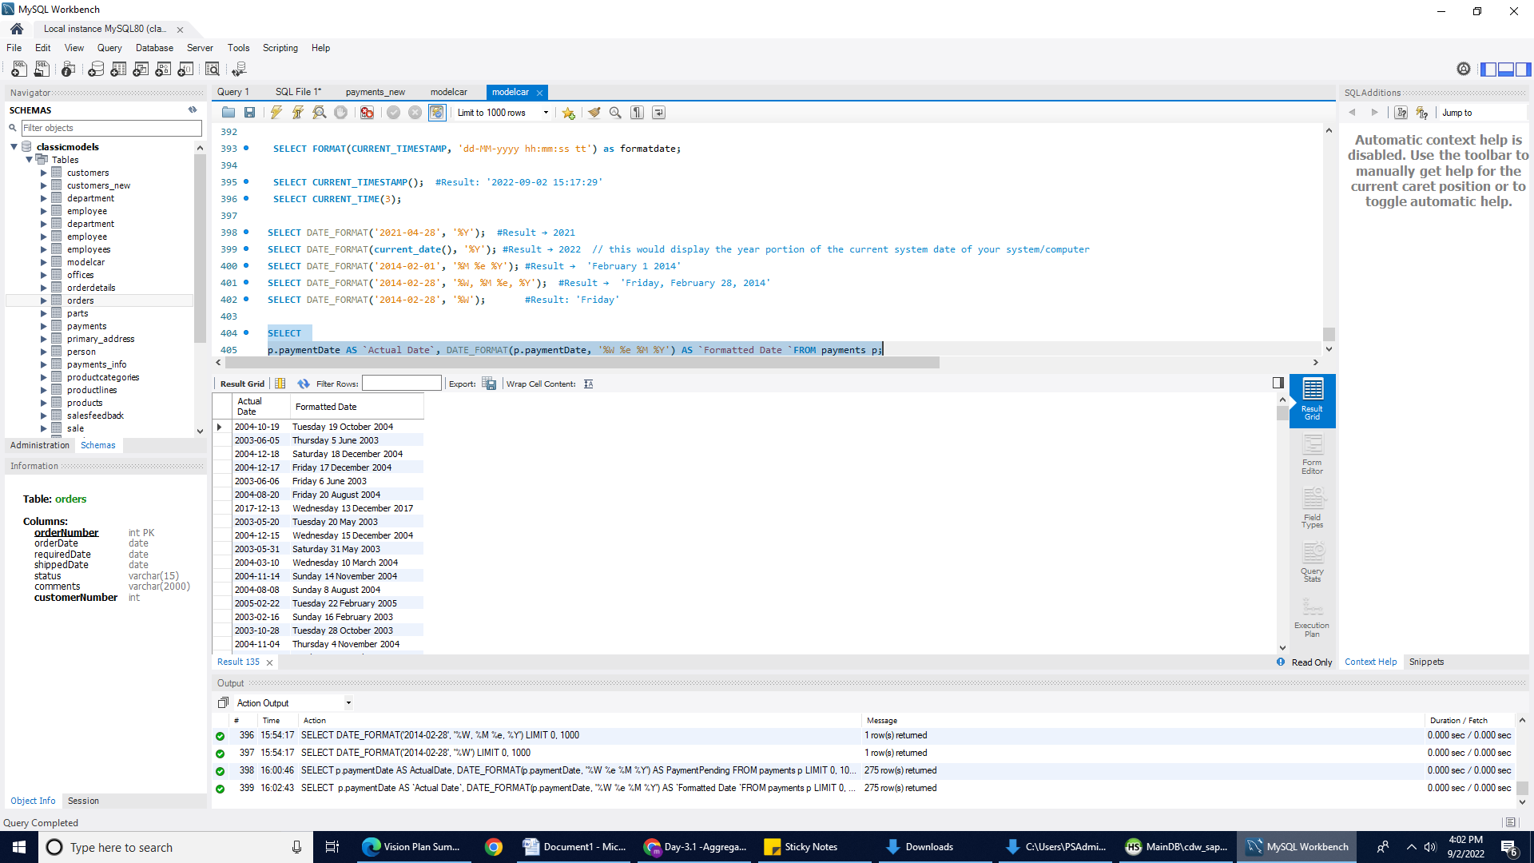
Example: DATE_FORMAT() Function
SELECT
p.paymentDate AS `Actual Date`,
DATE_FORMAT(p.paymentDate, '%W %e %M %Y') AS `Formatted Date`
FROM payments p;
Result:
As you can see in the screenshot, We used paymentDate column from the payment table. We formatted the date in a more readable format by using the DATE_FORMAT() function.

Slide 28
Date Functions → DATEDIFF() Function
The DATEDIFF() function calculates the number of days between two DATE, DATETIME, or TIMESTAMP values.
Syntax: DATEDIFF(date_expression_1, date_expression_2);
The DATEDIFF() function accepts two arguments that can be any valid date or date-time values. If you pass DATETIME or TIMESTAMP values, the DATEDIFF function only takes the date parts for calculation and ignores the time parts.
The DATEDIFF() function is useful in many cases e.g., you can calculate an interval in days that the products need to ship to a customer.
Example:
SELECT DATEDIFF('2021-01-28', '2021-01-27'); #Result: 1
SELECT DATEDIFF('2021-01-28 11:41:14', '2021-01-27 12:10:08'); #Result: 1
SELECT DATEDIFF('2029-02-15', '2021-02-10'); #Result: 2927
SELECT DATEDIFF('2014-01-28', '2013-12-31'); #Result: 28
SELECT DATEDIFF('2013-12-31', '2014-01-28'); #Result: -28
SELECT DATEDIFF(CURDATE(), '2014-02-14'); # Result: This would display the difference between current system date and '2014-02-14'

Slide 29
Example: DATEDIFF() Function
Let’s calculate the number of days between the current date and the order received data. Calculate the number of days between current date and shipping date of the orders table. We can utilize the CURRENT_DATE() function and the DATEDIFF() function.
SELECT
CURRENT_DATE(), orderDate,
DATEDIFF(CURRENT_DATE() , orderDate) as 'Orders received Days',
DATEDIFF(CURRENT_DATE() , shippedDate) as 'Order Shipping Days'
from classicmodels.orders

Slide 30
Advanced Functions
Let's demonstrate the most commonly used SQL Advanced Functions that allow you to manipulate data effectively.

Slide 31
Advanced Functions → IF() Function
The IF() function returns one value if a condition evaluates to TRUE, or another value if it evaluates to FALSE.
Syntax: IF( condition, [value_if_true], [value_if_false] )
Example:
SELECT IF(100<200, 'yes', 'no'); #Result → 'yes'
SELECT IF(500<1000, 5, 10); #Result → 5 //Return 5 if the condition is TRUE, or 10 if the condition is FALSE:
SELECT OrderNumber, quantityOrdered, IF(quantityOrdered>30, "MORE", "LESS") FROM OrderDetails;
# Result → Return "MORE" if the condition is TRUE, or "LESS" if the condition is FALSE:

Slide 32
Example: IF() Function
Example 1: Let's utilize the OrderDetails table from the classicmodel database. The following query will return "MORE" if the number of items ordered is greater than 30, and "LESS" if the number of items ordered is less than 30.
SELECT OrderNumber, quantityOrdered, IF(quantityOrdered>30, "MORE", "LESS") FROM classicmodels.OrderDetails;
Example 2: The IF() function is useful when it combines with an aggregate function. Suppose you want to know how many orders have been shipped and cancelled. You can use the IF() function with the SUM() function as the following query:
SELECT
SUM(IF(status = 'Shipped', 1, 0)) AS Shipped,
SUM(IF(status = 'Cancelled', 1, 0)) AS Cancelled
FROM
classicmodels.orders;
Notes:
In the example 2, if the order status is shipped or cancelled , the IF function returns 1 otherwise it returns 0. The SUM function calculates the total number of shipped and cancelled orders based on the returned value of the IF function.

Slide 33
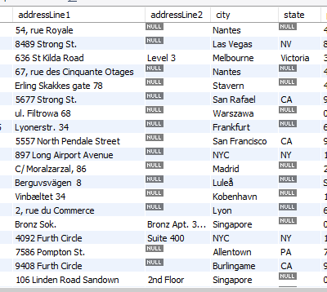
Advanced Functions → IFNULL() unction
The IFNULL() Function is one of the MySQL control flow functions that accepts two arguments and returns the first argument if it is not NULL. Otherwise, the IFNULL function returns the second argument.
Consider the customer's table. You will notice that column addressLine2 has some NULL values. We can set the condition if addressLine2 is NULL, and then print addressLine1.
The query is shown on the next slide.

Slide 34
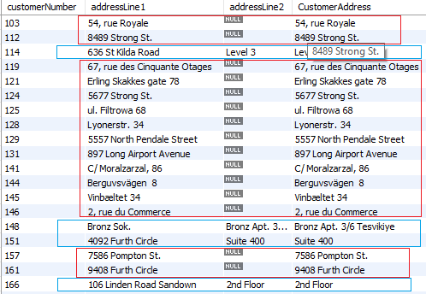
Advanced Functions → IFNULL() function - (Continued)
SELECT customerNumber, addressLine1, addressLine2,
IFNULL(addressLine2, addressLine1) as CustomerAddress
from customers;

Slide 35
MD5() Function
The MD5() function Calculates an MD5 128-bit checksum for a string. The value is returned as a hash key (binary string of 32 hex digits), or NULL if the argument was NULL.
Syntax: MD5(str);
SELECT MD5('MypasswordFor20Dollar$');
The above query will return MD5 value of MypasswordFor20Dollar$.
The return value is 94ee18f13cd3b9d3243a14177735e9f6.

Slide 36
CAST() Function
The CAST() function converts a value from one datatype to another datatype.
Syntax: CAST(value AS type).
value: The value to convert to another datatype.
type: The data type that you wish to convert value to. It can be one of the following:
DATE, DATETIME, TIME, CHAR, SIGNED, UNSIGNED, BINARY
Example:
SELECT CAST('2014-02-28' AS DATE); #Result: '2014-02-28'
SELECT CAST(125 AS CHAR); #Result: '125'
SELECT CAST(4-6 AS UNSIGNED); #Result: 18446744073709551614
# UNSIGNED converts a value to the UNSIGNED data type that contains the unsigned 64-bit integer.
SELECT CAST("14:06:10" AS TIME); #Result: 14:06:10

Slide 37
SQL Functions
Visit below link for more SQL functions
https://dev.mysql.com/doc/refman/8.0/en/functions.html

Slide 38
Hands-On Lab: Aggregate Function
Complete the lab GLAB - 304.5.1 - Aggregate Functions. You can find this Lab on Canvas under Assignment section.
Note: If you have any technical questions while performing the lab activity, ask your instructors for assistance.

Slide 39
Section 2
____________________________
SQL Operators
Learning Objective:
By the end of this lesson, learners will be able to
Describe SQL operators, including Logical Operators, Arithmetic Operators, Comparison Operators.
Explain common SQL operators.

Slide 40
Table of Contents
Overview of SQL Operators:
Logical Operators.
Arithmetic Operators.
Comparison Operators.
IS NULL and IS NOT NULL Operators.
IN Operator.
Overview of CASE Statement.

Slide 41
Overview of SQL Operators
SQL comes with special characters or words to perform certain operations. MySQL Operators are applied to the operands in order to carry out specific operations.
SQL operators common categories are:
Logical Operators.
Arithmetic Operators.
Comparison Operators.

Slide 42
Logical Operators
Some Logical Operators are -
Operator | Description
BETWEEN | It is used to search within a set of values, by the minimum value and maximum value provided.
EXISTS | It is used to search for the presence of a row in a table which satisfies a certain condition specified in the query.
OR | It is used to combine multiple conditions in a statement by using the WHERE clause.
AND | It allows the existence of multiple conditions in an SQL statement by using the WHERE clause.
NOT | It reverses the meaning of the logical operator with which it is used. (Examples: NOT EXISTS, NOT BETWEEN, NOT IN, etc.)
IN | It is used to compare a value in a list of literal values.
ALL | It compares a value to all values in another set of values.
ANY | It compares a value to any value in the list according to the condition specified.
IS NULL | It compares a value with a NULL value.
UNIQUE | It searches for every row of a specified table for uniqueness (no duplicates).

Slide 43
Arithmetic Operators
In SQL, arithmetic operators are used to perform the arithmetic operations as described below:
Operator | Description | Example
+ | Addition of two operands | a + b
– | Subtraction of right operand from the left operand | a – b
* | Multiplication of two operands | a * b
/ | Division of left operand by the right operand | a / b
% | Modulus – the remainder of the division of left operand by the right | a % b

Slide 44
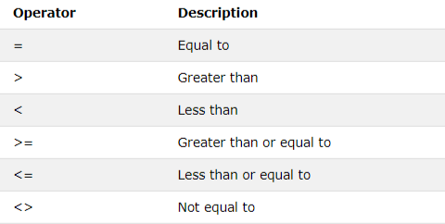
Comparison Operators
The comparison operators in SQL are used to compare values between operands and return true or false according to the condition specified in the statement.

Slide 45
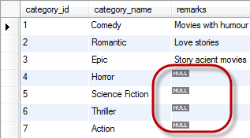
IS NULL and IS NOT NULL Operators
IS Null and IS NOT NULL both are logical operators. To test whether a value is NULL or not, we can use the IS NULL operator.
IS NULL Syntax: 🡪 SELECT column_names FROM table_name WHERE column_name IS NULL;
IS NOT NULL Syntax 🡪 SELECT column_names FROM table_name WHERE column_name IS NOT NULL;

Slide 46
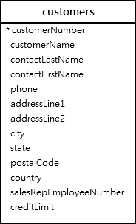
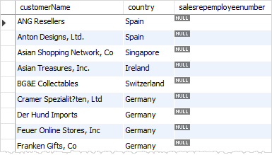
Example: IS NULL Operators
We will use the customers table in the classicmodels database for the demonstration. The following query uses the IS NULL operator to find customers who do not have a sales representative:
SELECT customerName, country, salesrepemployeenumber
FROM classicmodels.customers
WHERE salesrepemployeenumber IS NULL
ORDER BY customerName;
Output

Slide 47
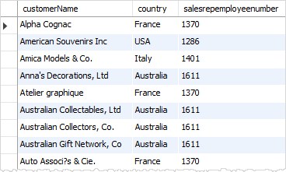
Example: IS NOT NULL Operators
We will use the customers table in the classicmodels database for the demonstration. The following query uses the IS NOT NULL operator to find customers who do not have a sales representative:
SELECT customerName, country, salesrepemployeenumber
FROM classicmodels.customers
WHERE salesrepemployeenumber IS NOT NULL
ORDER BY customerName;
Output

Slide 48
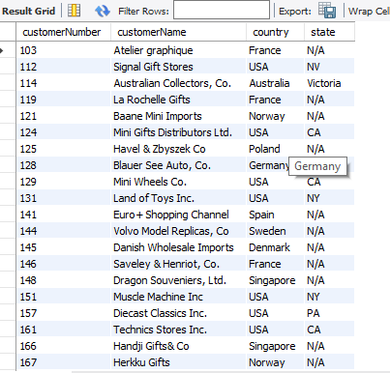
Example: IF() function and IS NULL Operator
In this example, we will utilize if() function and IS NULL operators.
In the customer's table, many customers do not have state information in the “state“ column; therefore, when we select customers, the state column displays NULL values, which is not meaningful for the reporting purpose. We can improve the output by using the IF function to return N/A if the state is NULL as the following query:
SELECT customerNumber, customerName, country,
IF(state IS NULL, 'N/A', state) as state
FROM classicmodels.customers;

Slide 49
IN Operator
The IN operator allows you to specify multiple values in a WHERE clause.
The IN operator allows you to determine if a specified value matches any value in a set of values or is returned by a subquery.
Syntax
Basic 🡪 SELECT column_name(s) FROM table_name WHERE column_name IN (value1,value2,...);
Advance 🡪 SELECT column_name(s) FROM table_nam e WHERE column_name IN (SELECT STATEMENT);
Example:
SELECT * FROM Customers WHERE country IN ('USA ', 'France ');
#You can achieve the same result with the OR operator as the following query:
SELECT * FROM Customers WHERE country = 'USA' OR country = 'France';
We can use the “IN” operator with a subquery. We will explore later in this course.

Slide 50
IN Operator Example
SELECT * FROM Customers WHERE Country IN ('Germany', 'France', 'UK');
SELECT * FROM Customers WHERE Country NOT IN ('Germany', 'France', 'UK');

Slide 51
Hands-On LAB - Operators
Complete the GLab - 304.5.2 - Operators. You can find this Lab on Canvas under Assignment section.
Note: if you have any technical questions while performing the lab activity, ask your instructors for assistance.

Slide 52
Practice Assignment
This assignment will be administered through HackerRank.
Click on the below links.
Weather Observation Station - CITY names from STATION
Weather Observation Station -difference between the total number of CITY entries
Weather Observation Station - Query the list of CITY names ending with vowels
Weather Observation Station - Query the list of CITY names from STATION which have vowels
Weather Observation Station - Query the list of CITY names from STATION that do not start with vowels
Weather Observation Station - Query the list of CITY names from STATION that either do not start with vowels or do not end with vowels
Weather Observation Station - Query the sum of Northern Latitudes (LAT_N)
Weather Observation Station - Query the greatest value of the Northern Latitudes (LAT_N) from STATION that is less than 137.23
Weather Observation Station - Query the Western Longitude (LONG_W) for the largest Northern Latitude (LAT_N) in STATION that is less than 137.23
Weather Observation Station - Query the smallest Northern Latitude (LAT_N) from STATION that is greater than 38.77
Weather Observation Station - Query the Western Longitude (LONG_W)where the smallest Northern Latitude (LAT_N) in STATION is greater than 38.77
Revising the Select Query I
Revising the Select Query II
String function
Note: Use your office hours to complete this assignment, If you have any technical questions while performing the assignment activity, ask your instructors for assistance.
This assignment does not count toward the final grade but these assignments will prepare you for the SBA

Slide 53
Overview of CASE Statement
The CASE statement is a Control Flow statement.
The CASE statement chooses from a sequence of conditions and runs the corresponding statement.
The CASE statement has two forms:
Simple - a single expression is evaluated and compared to potential matches.
Searched - multiple conditions are evaluated and the first true condition is selected.

Slide 54
Syntax: Simple CASE Statement
CASE given_value
WHEN condition_value_1 THEN statements_1
WHEN condition_value_2 THEN statements_2
...
WHEN condition_value_n THEN statements_n
[ ELSE else_statements ]
END CASE;
The given_value is an expression – usually a scalar variable. Each condition_value can be either literal or an expression, and all must be of the same data type as the given_value.
The simple CASE statement runs the first statements for which the given_value equals the condition_value. If no value matches, the else_statements will run if they are present.
Notes:
Start with CASE within it provide N number of conditions based on WHEN and THEN.
Use END at the final stage of CASE to end the statement.

Slide 55
Syntax: Searched CASE Statement
CASE
WHEN condition_1 THEN statements_1
WHEN condition_2 THEN statements_2
...
WHEN condition_n THEN statements_n
[ ELSE else_statements ]
END CASE;
The searched CASE statement executes the first statements for which the condition evaluates true. Remaining conditions are not evaluated. If no condition is true, the CASE statement runs the else_statements if they exist. Otherwise the statement evaluates to NULL.

Slide 56
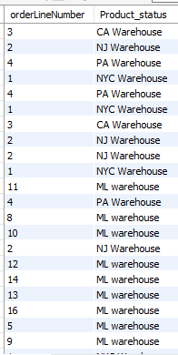
Example 1: Simple CASE statement
In this example, we will use a simple CASE statement to determine the warehouse based on the orderLinenumber column from orderdetails table.
SELECT orderLineNumber,
CASE od.orderLineNumber
WHEN 1 THEN 'NYC Warehouse'
WHEN 2 THEN 'NJ Warehouse'
WHEN 3 THEN 'CA Warehouse'
WHEN 4 THEN 'PA Warehouse'
ELSE 'ML warehouse'
END AS Product_status
FROM classicmodels.orderdetails od;
Result

Slide 57
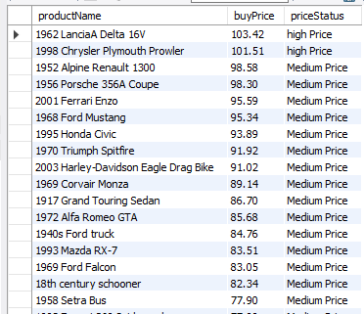
Example 1 - Searched Case Statements
In this example, we will use a search CASE Statement to determine the status of the buying price on the buyPrice column from products table.
SELECT productName, buyPrice,
CASE
WHEN buyPrice > 9 AND buyPrice <= 50 THEN "LOW PRICE"
WHEN buyPrice >= 50 AND buyPrice <= 100 THEN "Medium Price"
WHEN buyPrice > 100 AND buyPrice <= 200 THEN "high Price"
ELSE "Out of our rang" END AS priceStatus
FROM products ORDER BY buyPrice DESC;
Result

Slide 58

Example 2 - Searched Case statements
The following example uses the CASE statement to sort customers by states if the state is not NULL, or sort the country in case the state is NULL:
SELECT customerName, state, country
FROM customers
ORDER BY ( CASE
WHEN state IS NULL THEN country
ELSE state
END);
Result

Slide 59
Knowledge Check
What is an aggregate function?
Does the COUNT() function return the number of columns in a table?
Which keyword is used to join multiple strings into a single string?

Slide 60
Summary
SQL offers aggregate functions that can help with the Data computation and manipulation, as seen in the list below. In order to create more sophisticated data manipulation with aggregate functions, you have to use the GROUP BY clause. This groups together all rows that have the same values. You can use the HAVING clause if you need to filter the result of an aggregate function.
SQL Functions
AVG() - Returns the average value.
COUNT() - Returns the number of rows.
FIRST() - Returns the first value.
LAST() - Returns the last value.
MAX() - Returns the largest value.
MIN() - Returns the smallest value.
SUM() - Returns the sum.UCASE() - Converts a field to uppercase.
ROUND() - Rounds a numeric field to the number of decimals specified.
NOW() - Returns the current system date and time.
The case statement in SQL returns a value on a specified condition. We can use a case statement in select queries along with the Where, Order By, and Group By clauses.

Slide 61
References
https://dev.mysql.com/doc/refman/5.7/en/case.html
https://dev.mysql.com/doc/refman/5.7/en/functions.html
https://dev.mysql.com/doc/refman/5.7/en/numeric-functions.html
https://popsql.com/learn-sql/mysql/how-to-write-a-case-statement-in-mysql

Slide 62

Questions?
‹#›

